Slide 1

INSTITUTE : UIE
DEPARTMENT : CSE
Bachelor of Engineering (Computer Science & Engineering)
Mobile Application Development(20CST-355)
TOPIC OF PRESENTATION:
Overview of Android Platform
Prepared by:
Parveen Kumar Saini(E13339)
DISCOVER . LEARN . EMPOWER

Slide 2
Overview of Android Platform

Slide 3
What is Android?
Android is an open source and Linux-based Operating System for mobile devices such as smartphones and tablet computers. Android was developed by the Open Handset Alliance, led by Google, and other companies.
The first beta version of the Android Software Development Kit (SDK) was released by Google in 2007 where as the first commercial version, Android 1.0, was released in September 2008.
On June 27, 2012, at the Google I/O conference, Google announced the next Android version, 4.1 Jelly Bean. Jelly Bean is an incremental update, with the primary aim of improving the user interface, both in terms of functionality and performance.

Slide 4
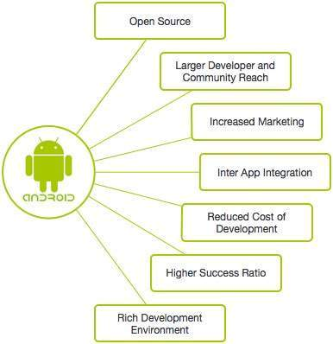
Why Android ?

Slide 5
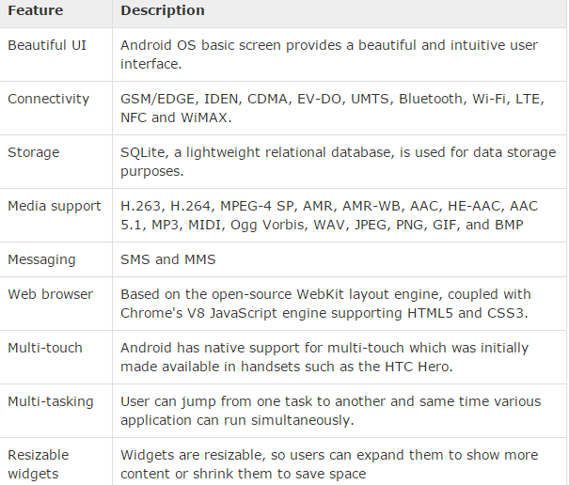
Features of Android

Slide 6
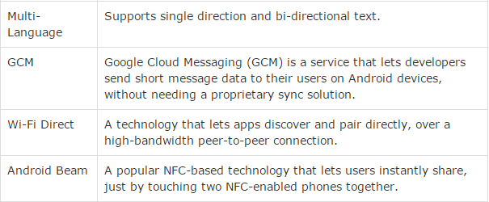
Features of Android

Slide 7
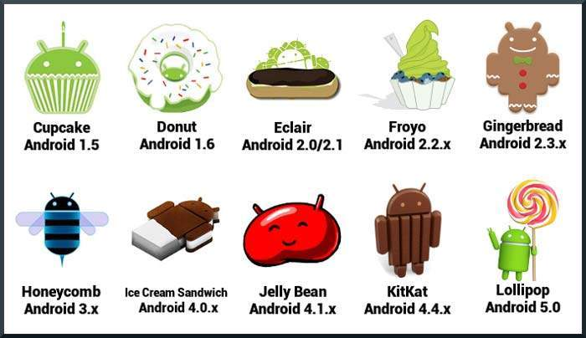
History of Android

Slide 8
What is API level?
API Level is an integer value that uniquely identifies the framework API revision offered by a version of the Android platform.

Slide 9
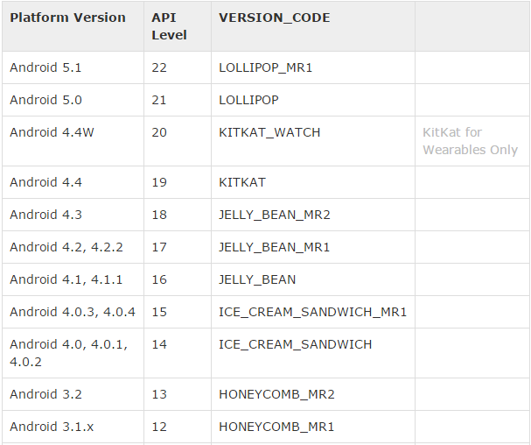
API Levels

Slide 10
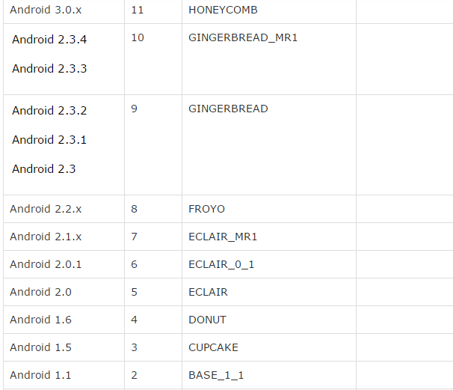
API LEVELS

Slide 11
Android - Environment Setup
Following is the list of software's you will need before you start your Android application programming.
Java JDK5 or later version
Android SDK
Java Runtime Environment (JRE) 6
Android Studio
Eclipse IDE for Java Developers (optional)
Android Development Tools (ADT) Eclipse Plug-in (optional)

Slide 12
Set-up Java Development Kit (JDK)
You can download the latest version of Java JDK from Oracle's Java site: Java SE Downloads. You will find instructions for installing JDK in downloaded files, follow the given instructions to install and configure the setup. Finally set PATH and JAVA_HOME environment variables to refer to the directory that contains java and javac, typically java_install_dir/bin and java_install_dir respectively.
If you are running Windows and installed the JDK in C:\jdk1.6.0_15, you would have to put the following line in your C:\autoexec.bat file.
set PATH=C:\jdk1.7.0_75\bin;%PATH% set JAVA_HOME=C:\jdk1.7.0_75 Alternatively, you could also right-click on My Computer, select Properties, then Advanced, then Environment Variables. Then, you would update the PATH value and press the OK button.
On Linux, if the SDK is installed in /usr/local/jdk1.6.0_15 and you use the C shell, you would put the following code into your .cshrc file.
setenv PATH /usr/local/jdk1.7.0_75/bin:$PATH setenv JAVA_HOME /usr/local/jdk1.7.0_75
www.cuchd.in Computer Science and Engineering Department

Slide 13
Android IDEs
Android Studio
Eclipse IDE

Slide 14
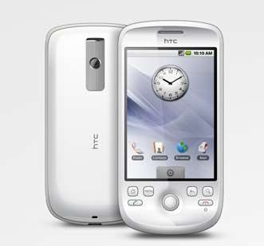
Android versions & API levels Version: 1.0 (Apple Pie) API level: 1
Android Market allowed application downloads and updates through the Market application
Gmail synchronization with the Gmail
application.
Google Search, allowing users to search the Internet and phone applications, contacts, calendar, etc.
Instant messaging, text messaging, and MMS

Slide 15

Version: 1.5 (Cupcake) API level: 3
Video recording and playback in MPEG- 4 and 3GP formats
Auto-pairing and stereo support for
Bluetooth (A2DP and AVRCP profiles)
Copy and paste features in web browser
User pictures shown for Favorites in Contacts
Auto-rotation option
Ability to upload videos to YouTube

Slide 16
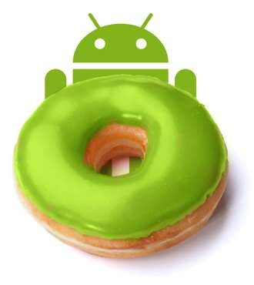
Version: 1.6 (Donut) API level: 4
Voice and text entry search enhanced to include bookmark history, contacts, and the web.
Ability for developers to include their
content in search results.
Multi-lingual speech
Easier searching and ability to view app screenshots in Android Market.
Gallery, camera and camcorder more fully integrated, with faster camera access.
Support for WVGA screen resolutions.
Speed improvements in searching and camera applications.

Slide 17
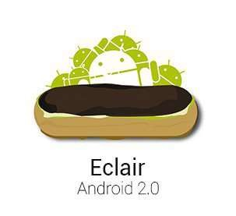
Version: 2.0 (Éclair) API level: 4
Improved typing speed on virtual keyboard, with smarter dictionary that learns from word usage and includes contact names as suggestions.
Refreshed browser UI with bookmark thumbnails, double-tap zoom and support for HTML5.
Support for more screen sizes and resolutions, with better contrast ratio.
Improved Google Maps 3.1.2.
MotionEvent class enhanced to track multi- touch events.

Slide 18
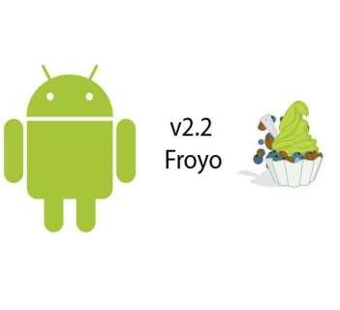
Version: 2.2 (Froyo) API level: 8
Speed, memory, and performance optimizations.
Additional application speed improvements,
implemented through JIT compilation.
Integration of Chrome's V8 JavaScript engine into the Browser application.
Support for the Android Cloud to Device Messaging (C2DM) service, enabling push notifications.
USB tethering and Wi-Fi hotspot functionality.
Adobe Flash support.

Slide 19
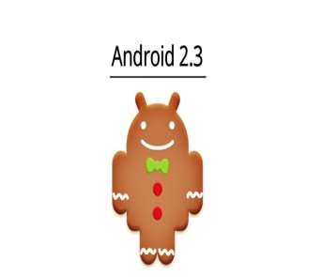
Version: 2.3 (Gingerbread) API level: 9
Native support for SIP VoIP internet telephony.
Enhanced support for native code
development.
Audio, graphical, and input enhancements for game developers.
Concurrent garbage collection for increased
performance.
New Download Manager, giving users easy access to any file downloaded from the browser, email, or another application.

Slide 20

Version: 3.0 (Honeycomb) API level: 11
Hardware acceleration
Support for multi-core processors
Ability to encrypt all user data
HTTPS stack improved with Server Name Indication (SNI)
Filesystem in Userspace (FUSE; kernel module)
Optimized tablet support with a new
“holographic” user interface
Quick access to camera exposure, focus, flash, zoom, front-facing camera, time-lapse, and other camera features

Slide 21

Version: 4.0 (Ice Cream Sandwich) API level: 14
Soft buttons from Android 3.x are now available for use on phones
Separation of widgets in a new tab, listed in a similar manner to applications
Easier-to-create folders, with a drag-and-drop
style
Improved error correction on the keyboard
Improved copy and paste functionality
Face Unlock, a feature that allows users to unlock handsets using facial recognition software
Built-in photo editor
1080p video recording for stock Android devices

Slide 22

Version: 4.1 (Jelly Bean) API level: 16
Smoother user interface
Enhanced accessibility
Bi-directional text and other language support
User-installable keyboard maps
Expandable notifications
Ability to turn off notifications on an application-specific basis
Bluetooth data transfer for Android Beam
Tablets with smaller screens now use an expanded version of the interface layout and home screen used by phones.
Improved camera application
Multichannel audio

Slide 23
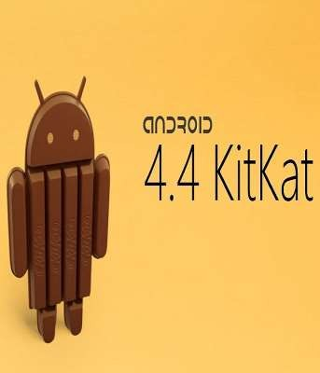
Version: 4.4 (KitKat) API level: 19
Refreshed interface with white elements instead of blue
Ability for applications to trigger translucency
in the navigation and status bars
NFC host card emulation, enabling a device to replace smart cards
Sensor batching, step detector and counter APIs
Audio tunneling, audio monitoring and
loudness enhancer
Built-in screen recording feature (primarily for developers, as usage of ADB is required)
Bluetooth Message Access Profile (MAP) support

Slide 24
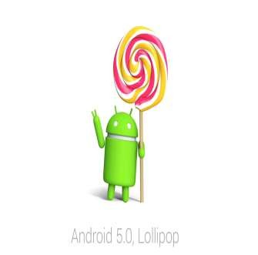
Version: 5.0 (Lollipop) API level: 21
Project Volta, for battery life improvements
Searches can be performed within the system settings for quicker access to particular settings
Lock screen provides shortcuts to application and notification settings
Guest logins and multiple user accounts are available on more devices, such as phones.
Audio input and output through USB devices
Smart lock feature
Updated emoji
Improved accessibility support (e.g. switch access support

Slide 25
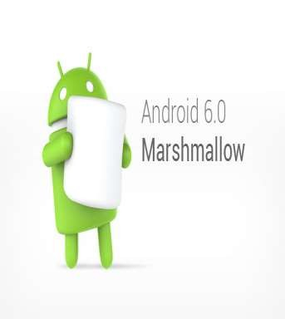
Version: 6.0 (Marshmallow) API level: 23
App Standby feature & alphabetically accessible vertical application drawer
Application search bar, favorites & native fingerprint reader support
Direct Share feature for target-specific sharing between apps
Renamed "Priority" to "Do Not Disturb" mode
App Linking for faster instinctive opening of
links with corresponding applications
Larger Application folders with multiple pages
4K display mode for apps and MIDI support for musical instruments

Slide 26
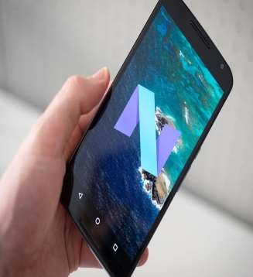
Version: 7.0 (Nougat) API level: 24
Daydream virtual reality platform
Improved Doze functionality, which aims to
prolong battery life
Replaced notification cards with notification sheets
Multi-window support, which supports floating apps on a desktop layout
Redesigned notification shade, featuring
instant access to certain settings
Picture-in-picture support for Android TV

Slide 27
OHA
The Open Handset Alliance (OHA) is a consortium of 84 firms to develop open standards for mobile devices.
Member firms include HTC, Sony, Dell, Intel, Motorola, Qualcomm, Texas Instruments, Google, Samsung Electronics, LG Electronics, T-Mobile, Sprint Corporation, Nvidia, and Wind River Systems.
The OHA was established on 5 November 2007, led by Google with 34 members
including mobile handset makers, application developers, some mobile carriers and chip makers.

Slide 28
Android - Architecture
Android operating system is a stack of software components which is roughly divided into five sections and four main layers as shown below in the architecture diagram.

Slide 29
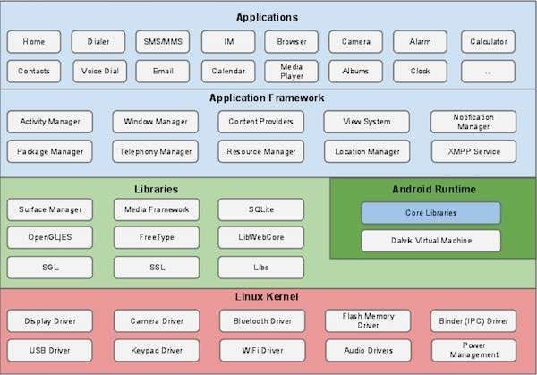

Slide 30
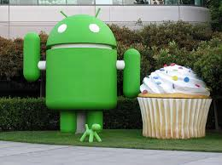
Android stack
System apps have no special status
System apps provide key capabilities to app developers
Example:
Your app can use a system app to deliver a SMS message.

Slide 31
Linux kernel
At the bottom of the layers is Linux - Linux 3.6 with approximately 115 patches. This provides a level of abstraction between the device hardware and it contains all the essential hardware drivers like camera, keypad, display etc. Also, the kernel handles all the things that Linux is really good at such as networking and a vast array of device drivers, which take the pain out of interfacing to peripheral hardware.

Slide 32
Libraries
On top of Linux kernel there is a set of libraries including open-source Web browser engine WebKit, well known library libc, SQLite database which is a useful repository for storage and sharing of application data, libraries to play and record audio and video, SSL libraries responsible for Internet security etc.

Slide 33
Android Libraries
android.app − Provides access to the application model and is the cornerstone of all Android applications.
android.content − Facilitates content access, publishing and messaging between applications and application components.
android.database − Used to access data published by content providers and includes SQLite database management classes.
android.opengl − A Java interface to the OpenGL ES 3D graphics rendering API.
android.os − Provides applications with access to standard operating system services including messages, system services and inter-process communication.
android.text − Used to render and manipulate text on a device display.
android.view − The fundamental building blocks of application user interfaces.
android.widget − A rich collection of pre-built user interface components such as buttons, labels, list views, layout managers, radio buttons etc.
android.webkit − A set of classes intended to allow web-browsing capabilities to be built into applications.

Slide 34
Android Runtime
This is the third section of the architecture and available on the second layer from the bottom. This section provides a key component called Dalvik Virtual Machine which is a kind of Java Virtual Machine specially designed and optimized for Android.
The Dalvik VM makes use of Linux core features like memory management and multi-threading, which is intrinsic in the Java language. The Dalvik VM enables every Android application to run in its own process, with its own instance of the Dalvik virtual machine.
The Android runtime also provides a set of core libraries which enable Android application developers to write Android applications using standard Java programming language.

Slide 35
Application Framework
The Android framework includes the following key services −
Activity Manager − Controls all aspects of the application lifecycle and activity stack.
Content Providers − Allows applications to publish and share data with other applications.
Resource Manager − Provides access to non-code embedded resources such as strings, color settings and user interface layouts.
Notifications Manager − Allows applications to display alerts and notifications to the user.
View System − An extensible set of views used to create application user interfaces.

Slide 36
E-resources
Jeff Mcwherter, Scott Gowell, Professional Mobile Application
Development, Wrox Publisher
https://www.academia.edu/22377111/Professional_Mobile_Application_Development
Lauren Darcy, Shane Conder, Sams Teach Yourself Android Application Development in 24 Hrs
LINK OF VIDEO: https://www.youtube.com/watch?v=TwXuY2w7Zv0 ( Tutorial Point)
LINK OF VIDEO: https://www.youtube.com/watch?v=t38wfcfm1E4 ( Seton Hall University)

Slide 37
THANK YOU
For queries
Email: parveen.e13339@cumail.in

